Slide 1
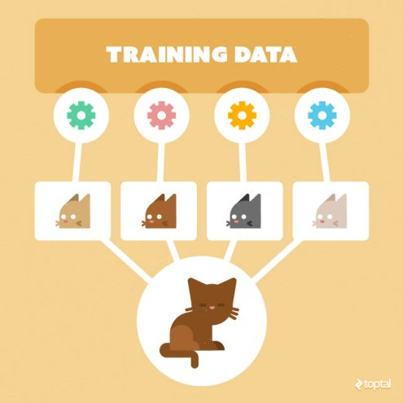
Leveraging Public APIs for Machine Learning Datasets
Johannes Ahlmann, Sensatus.io
PyCon 2019
2019-10-12

Slide 2

About Me
Johannes Ahlmann
Living in Cork
Developing in Python since 2002
Built large-scale Machine Learning solutions using Python, Tensorflow, Kafka, Spark
Sensatus.io
On-Prem AI Models
Gathering and Enriching Web Data
Sales & Client Intelligence
Github: @codinguncut
codinguncut/leveraging_public_apis
sensatus.io

Slide 3
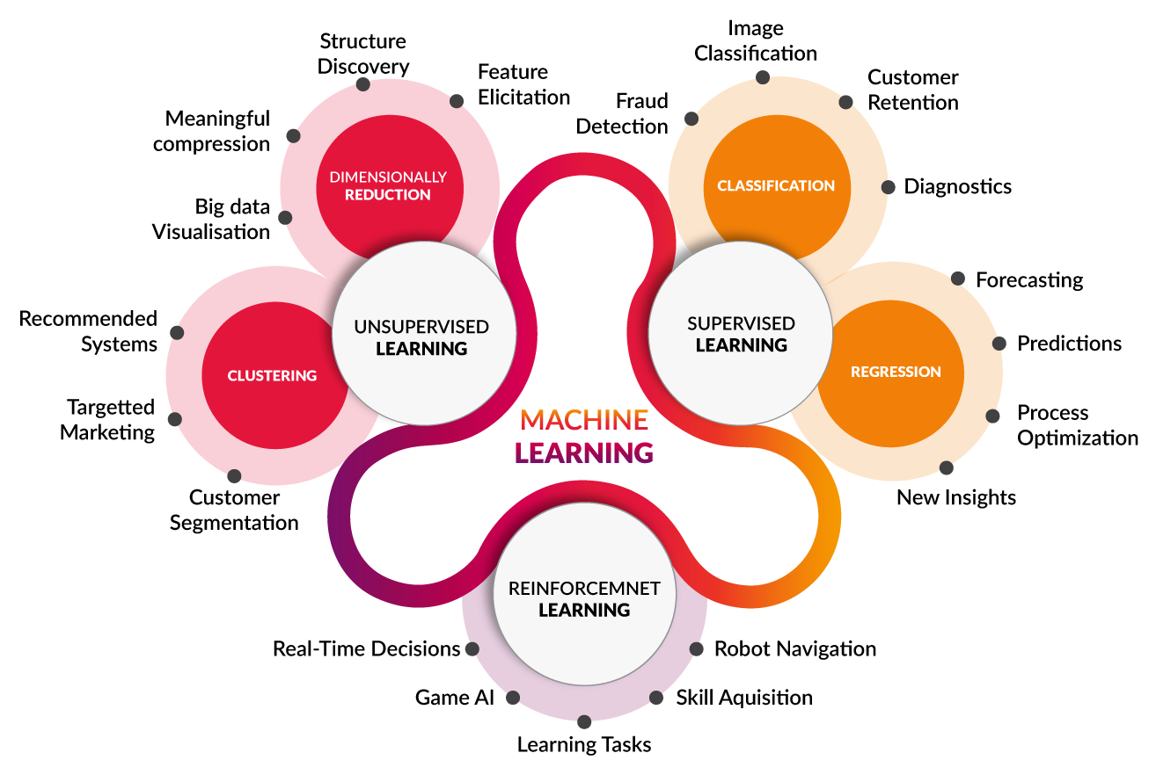
Requires large annotated training data
Can be hard to validate, guide
Requires an interactive environment

Slide 4
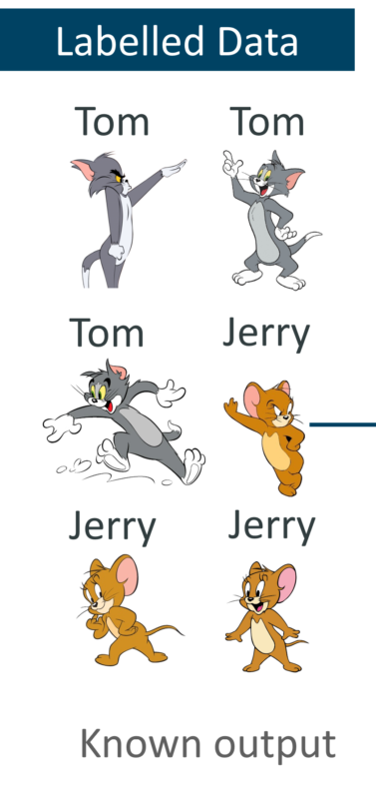
Supervised Machine Learning
Natural Language Processing
Machine Translation
Sentiment Analysis
Document Classification
Named Entity Extraction
Speech
Speech-to-Text
Text-to-Speech
Machine Vision
Object detection
Object classification
Facial Recognition
Semi-Supervised
Embeddings

Slide 5
Do we need Training Data?
Customizing a model, Transfer Learning
Generic models vs. Use Case specific
Access to Intermediate representations (i.e. for speech-to-text)
Speech-to-Text
Specific to regional accents, dialects, jargon
Specific to constrained contexts (i.e. call center calls)
Sentiment Analysis
Cultural differences, Jargon, etc.
NLP for different languages beyond [English, Spanish, French, German]

Slide 6
Web Scraping
APIs and existing datasets will only get us so far
Web Scraping enables us to extract data from publicly accessible websites
Possible to extract structured data from websites
Possible to fetch data from millions of pages, as long as we follow best practices and politeness
Python Tools
scrapy/scrapy
scrapinghub/frontera
scrapinghub/splash

